Slide 1
Hackathon Machine Learning
Submitted by Pro Squad
Apoorva, Deepak, Kunal & Yogesh

Slide 2

INDEX
1. Problem Statement
4. Binning
2. Challenges
5. Data Analysis
6. ML & Business Insights
3. Missing Value Treatment

Slide 3
PROBLEM STATEMENT
Problem
Context
Relevance
AIMs & Objectives
Mall has provided historical data which comprises of recommended coupons, customer details and coupon consumption details of previous years
Mall is going to run the campaign again and based on the historical data of coupons effectiveness they want to increase the footfalls in the Mall which will help the mall to increase business for the shops in the mall.
The AIM of the project is to come out with Business Insights on the data provided and Train a Machine Learning model which can predict the success of campaign with highest accuracy percentage.
A mall is doing a coupon campaign and wants to ensure the success of campaign using a Robust prediction model built with Machine Learning techniques.

Slide 4
CHALLENGES IN HISTORICAL DATA
26 features – 9 Numerical and 17 Categorical
Missing values in 5 Columns
Categorical Columns have Multiple labels, going to maximum 25 labels in 1 column.
Categorical Data has outliers and skewness
Most of the features are correlated

Slide 5
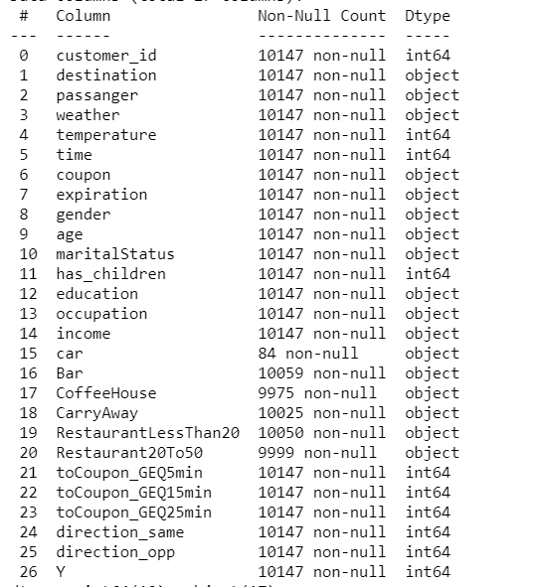
MISSING VALUE TREATMENT
Car – There are 84 values only out of 10147 in this column which is less then 1% hence we removed this column as it has no impact.
Bar, CoffeeHouse, CarryAway, RestaurantLessThan20, Restaurant20To50 – These have missing values around 2% hence we have used the Feature engineering technique to fill the most commonly occurring value out of the total values available in these columns.

Slide 6
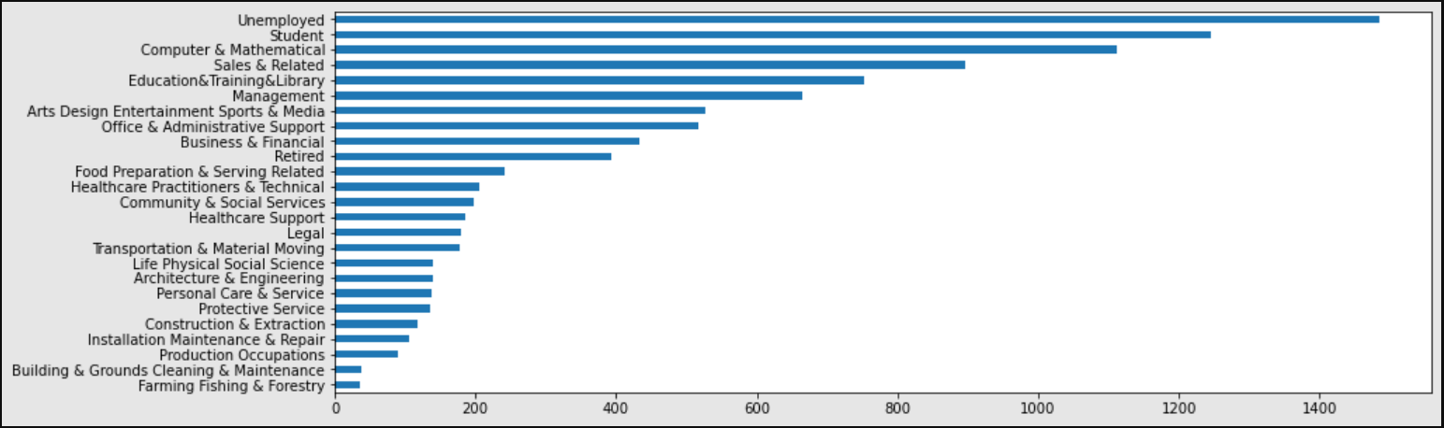

BINNING
Occupation column has 25 labels and the data frequency variation is very high creating outliers and skewness, so we used the Binning technique to reduce the number of labels hence removed the outliers and skewness

Slide 7

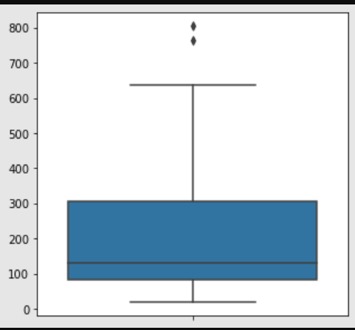
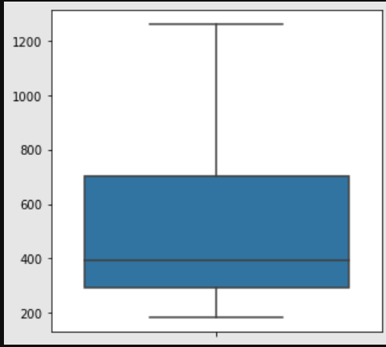
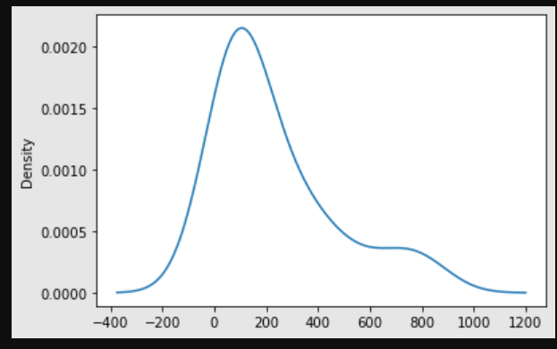
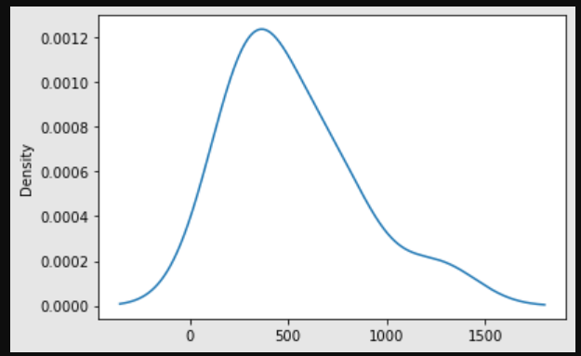
BINNING CONTD.
Outliers: In Figure – 1, we can see two dots, these are outliers which we tackled with binning and hence Figure - 2 shows the result of binning on the categorical column
Fig. : 1
Fig. : 2
Skewness: In Figure – 3, we can see the curve is skewed on the right, which we have tackled with binning and post processing; Figure – 4, shows the result of binning on the categorical column
Fig. : 3
Fig. : 4

Slide 8
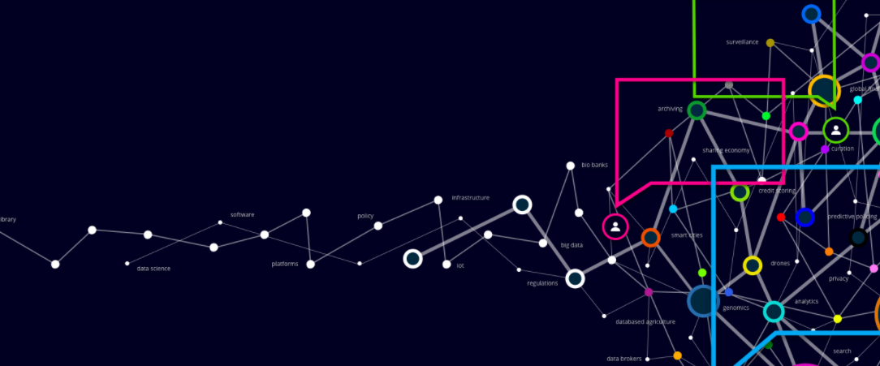
DATA ANALYSIS
Success of Coupons (Historical Data)
Age Vs Coupons (Historical Data)
Age group from 21 to 31 and 50+, the coupon usage is very high. Below 21 years the coupon distribution is low and hence the usage.
Coffee House, Carry out and Restaurant(<20) were the most successful coupons

Slide 9
DATA ANALYSIS CONTD.
Occupation Vs Coupon Success (Historical Data)
Marital Status (Historical Data)
Age group from 21 to 31 and 50+, the coupon usage is very high. Below 21 years the coupon distribution is low and hence the usage.
Student, Unemployed, computer professionals and Retired categories the success rate is high.

Slide 10
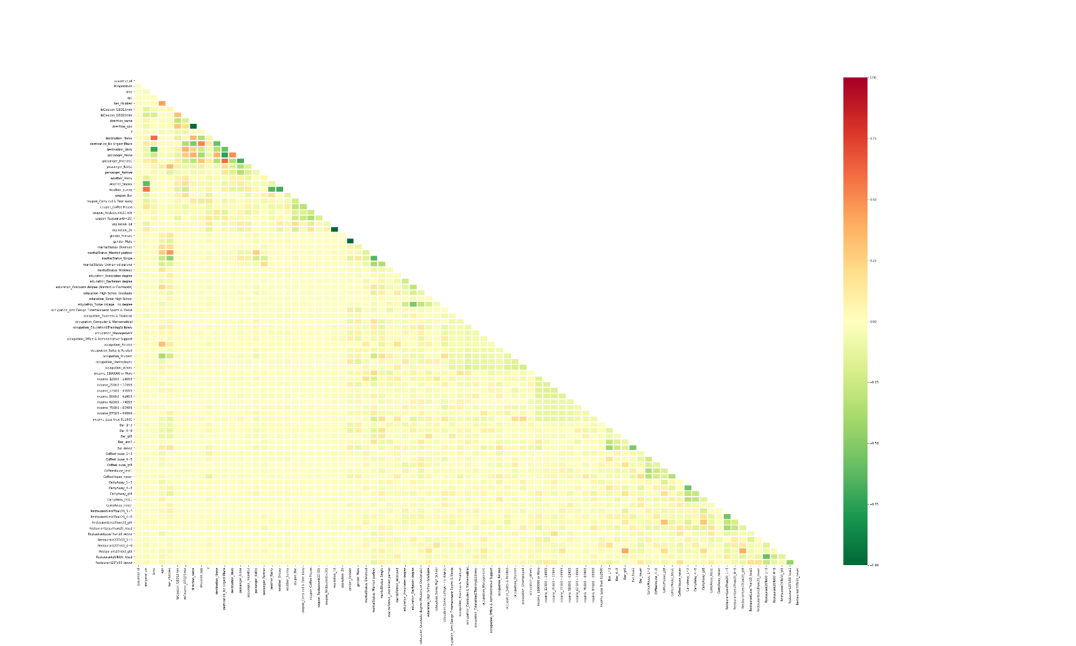
DATA ANALYSIS CONTD.
Multicollinearity Chart
Colour Legend
Yellow shade – Correlation is 0
Red and Dark Green is -1 and +1
Business Understanding
Customer ID, Temperature, Time, Weather, Direction, Passenger and Driving Distance impact is very low
Age, Has Children, Marital status, Gender, Occupation the impact is intermediate.
Restaurant type visit rating has the highest impact

Slide 11
MACHINE LEARNING MODEL
ML Models with their accuracy scores
ML Model 1: Logistic Regression
Logistic Regression
Cross Validation
Accuracy
68.97%
ML Model 2: Decision Tree
Decision Tree
Hyper Tuning
Cross Validation
Accuracy
70.95%
ML Model 3: Random Forest
Random Forest
Hyper Tuning
Cross Validation
Accuracy
76.63%

Slide 12
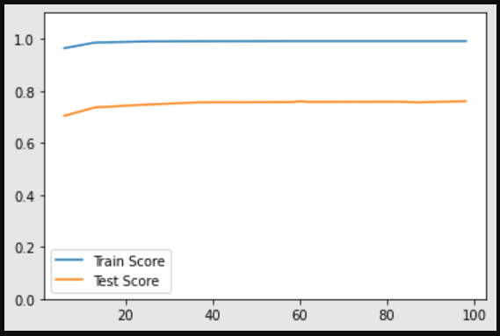
MACHINE LEARNING (HYPERTUNING)
Random Forest – Hyper Tuning to get accuracy
No of Estimators: We used Randomize Search and Grid Search to find the optimum number of Estimators (Trees) which can give the highest accuracy score and then used the same in our Machine Learning Model.
No of Folds: We used 5 folds to create random test and train split within the model to generate 5 accuracy scores and based on which the average score got select as the most optimum score.
Random State: We have tuned the Random state to 80 which is giving the maximum accuracy score in our model.

Slide 13

Business Insights
Advantages to Business
Coffee, Restaurant (<20) and Take away coupons are more successful.
Coupons are mostly used by age group 21 to 31 and 50+
Computer Workers, Retired, students and Unemployed are mostly using the coupons.
Customers tend to use the coupons if Driving Distance is between 5 to 15 minutes.
Customers tend to use the coupons mostly when the weather is sunny.
Carry away coupons utilization is most for customers using it 1~3 times in a month.
Most footfalls are at 7:00 AM and 6:00 PM, probably to pick a snack.

Slide 14


